Slide 1

CSE 464/598 : Software Quality Assurance and Testing
NextDate Problem – Analysis
Janaka Balasooriya

Slide 2
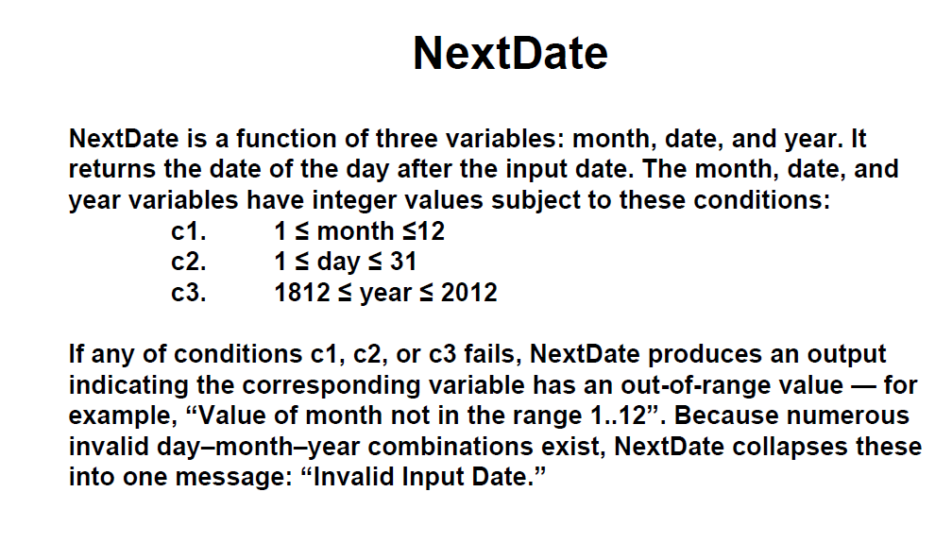
NextDate Problem

Slide 3
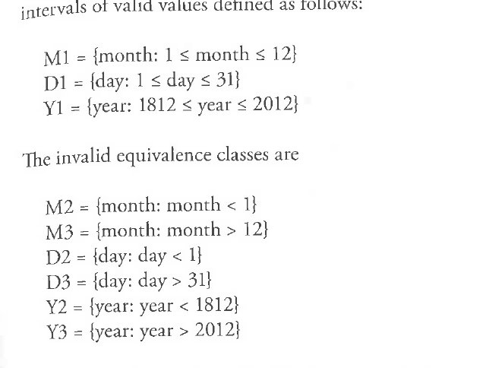
Equivalent Partitioning – First Attempt

Slide 4
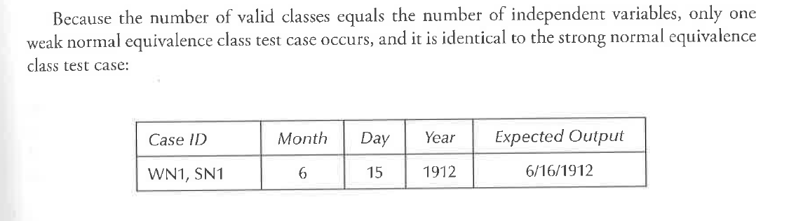
Test Cases – First Attempt

Slide 5
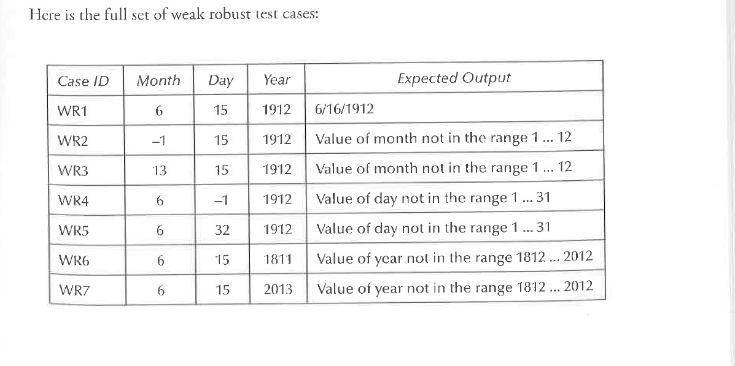
Test Cases – First Attempt

Slide 6
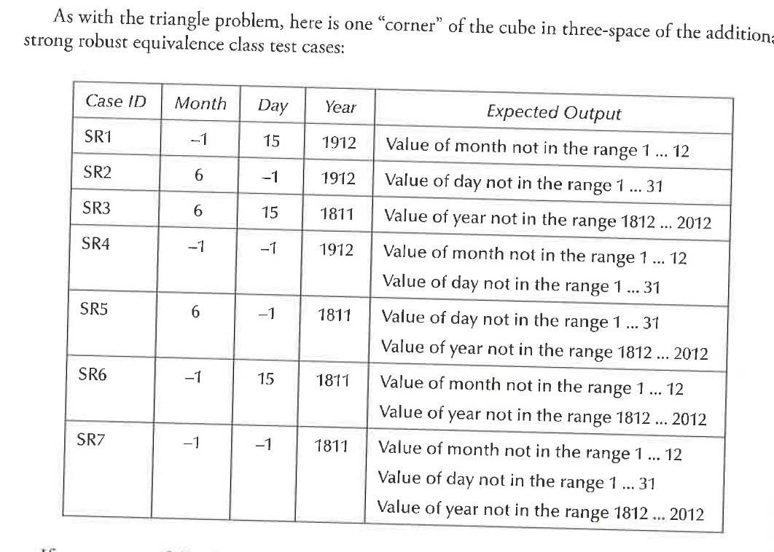
Test Cases – First Attempt

Slide 7
Drawbacks of the Current Approach ?
Class Discussion

Slide 8
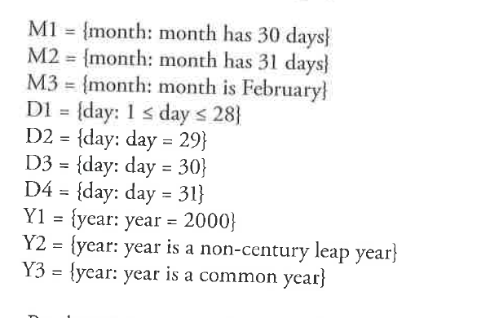
Equivalent Partitions – Second Approach
The year is evenly divisible by 4;
If the year can be evenly divided by 100 (century year), it is NOT a leap year, unless;
  The year is also evenly divisible by 400. Then it is a leap yea

Slide 9
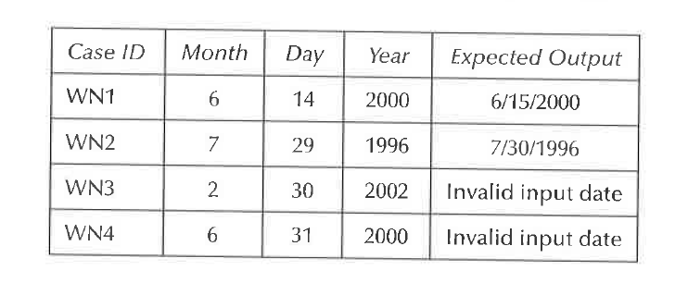
Weak Normal Test Cases

Slide 10
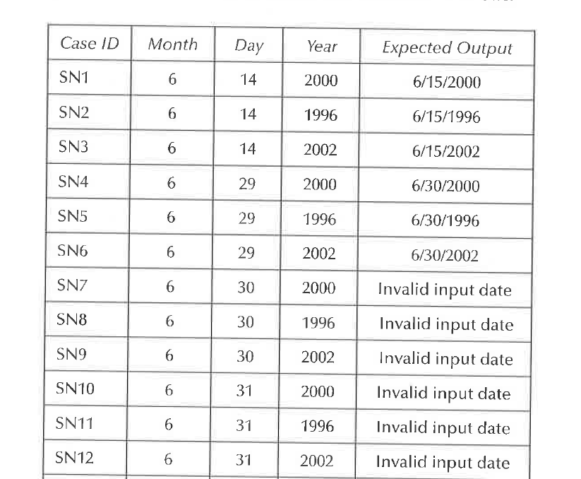
Strong Normal – Some Test Cases

Slide 11
Complete Remaining Test Cases for the NextDate Method

